Slide 1

Food Ordering System
RNS INSTITUTE OF TECHNOLOGY
BENGALURU - 98
DEPARTMENT OF INFORMATION SCIENCE & ENGINEERING
Presentation on Internship
Shreyas H.R
USN: 1RN18IS102
TechieAid
Internal Guide
Dr. S Sathish Kumar
Asst. Prof, Dept of ISE, RNSIT
External Guide
Mr. Ramesh
TechieAid

Slide 2
AGENDA
Abstract
About the Company
Introduction
Requirements
System Design
Detailed Design
Implementation
Conclusion and Future Enhancements
References
Q & A

Slide 3
ABSTRACT
The purpose of this project is to develop a computerized and mobilized food ordering system that can be used to revolutionize the traditional ordering system that currently implemented in majority of the food and beverage industry.
The traditional system that using by most of the food and beverage industry is the traditional manual ordering system which means all works and procedures is recorded through manpower manual work and it consist of a huge amount of paper work that is not effective and efficiency.
This cause the business to encounter trouble which regarding human error due to the huge amount of manpower manual work that operating in each business routine.
Thus, this computerized and mobilized food ordering system is designed to assist the business routine in term of having better management as well as easier to handle daily business operation.

Slide 4
About the Company
TechieAid is IT services company registered under Govt. of India, Ministry of Micro, Small & Medium Enterprises (MSME).
TechieAid offers Software Development Services, Staffing Solutions, Technology Training, Leadership & Soft Skills Training and Coaching & Mentoring
TechieAid core team comes with 20+ years of industry experience

Slide 5
INTRODUCTION
Food Ordering System is an application which will help restaurant to optimized and control over their restaurants. For the waiters, it is making life easier because they don’t have to go kitchen and give the orders to chef easily.
For the management point of view, the manager will able to control the restaurant by having all the reports to hand and able to see the records of each employees and orders.
This application helps the restaurants to do all functionalities more accurately and faster way. Food Ordering System reduces manual works and improves efficiency of restaurant.
PROPOSED SYSTEM
The proposed system is developed to manage ordering activities in fast food restaurant. It helps to record customer submitted orders. The system should cover the following functions in order to support the restaurant’s business process for achieving the objectives:
1. To allow the customer to make order, view order and make changes before submitting their order and allow them make payment through prepayment card or credit card or debit card.
2. To provide interface that allows promotion and menu.
3. To prevent interface that shows customers’ orders detail to front-end and kitchen staffs for delivering customers’ orders

Slide 6
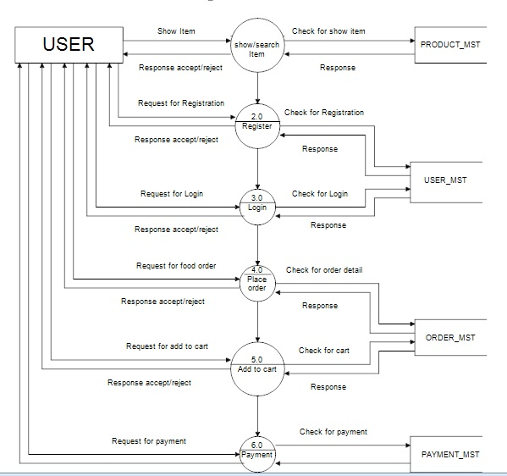
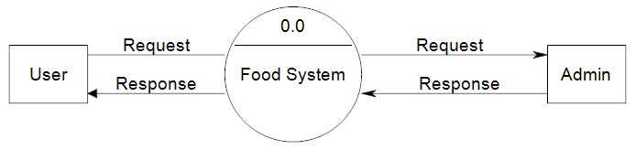
SYSTEM DESIGN
1 LEVEL DFD
1st level DFD for user

Slide 7
REQUIREMENTS
Software Requirement
Operating System : Windows (Any version above XP)
Programming language: .NET4.0, VISUAL STUDIO2019
Web-Technology : ASP.NET
Back-End : SQL SERVER 2016
Web Server : IIS.
Hardware Requirement
Pentium-IV(Processor).
4 GB Ram
512 KB Cache Memory
Hard disk 10 GB
Microsoft Compatible 101 or more Key Board

Slide 8
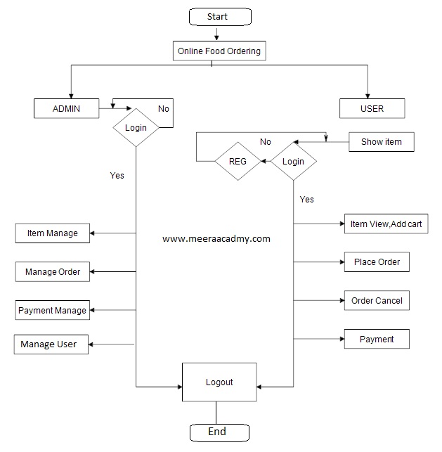
DETAILED DESIGN

Slide 9
IMPLEMENTATION
Implementation is the stage where the theoretical design is turned into a working system. The most crucial stage in achieving a new successful system and in giving confidence on the new system for the users that it will work efficiently and effectively.
Front End Technology
1) Microsoft .NET Framework
The .NET Framework is a new computing platform that simplifies application development in the highly distributed environment of the Internet.
2) Database
A database is similar to a data file in that it is a storage place for data. Like a data file, a database does not present information directly to a user; the user runs an application that accesses data from the database and presents it to the user in an understandable format.
3) Client/Server
In a client/server system, the server is a relatively large computer in a central location that manages a resource used by many people. When individuals need to use the resource, they connect over the network from their computers, or clients, to the server.
4) .NET Framework Class Library: -
The .NET Framework class library is a collection of reusable types that tightly integrate with the common language runtime. The class library is object oriented, providing types from which your own managed code can derive functionality.

Slide 10
IMPLEMENTATION
BACK-END TECHNOLOGY
About Microsoft SQL Server 2016
Microsoft SQL Server is a Structured Query Language (SQL) based, client/server relational database. Each of these terms describes a fundamental part of the architecture of SQL Server.
SQL Server Features
Microsoft SQL Server supports a set of features that result in the following benefits:
Ease of installation, deployment, and use
Scalability
Data warehousing
System integration with other server software
Connections
Data Adapters (OLEDB/SQL)
C# Language
C# (pronounced C Sharp) is a multi-paradigm programming language that encompasses functional, imperative, generic, object-oriented (class-based), and component-oriented programming disciplines.

Slide 11
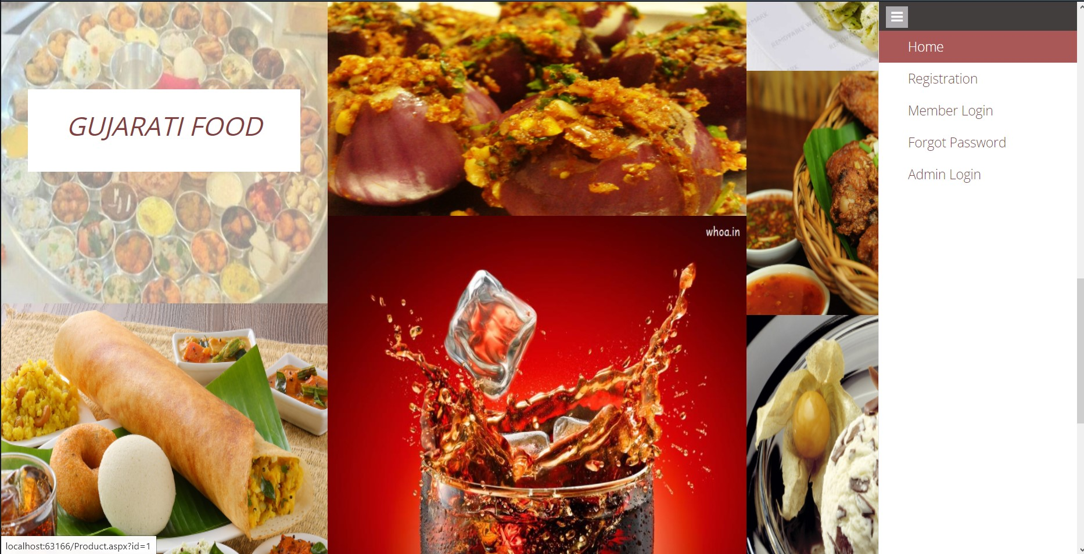
RESULT
Home Page

Slide 12
RESULT
Admin Login Page

Slide 13
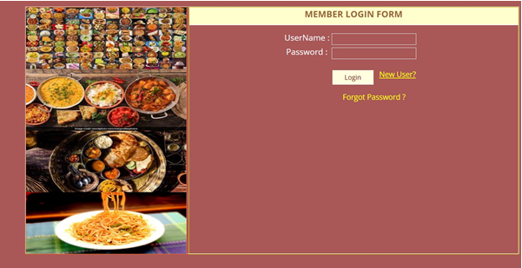
RESULT
Member Login Page

Slide 14
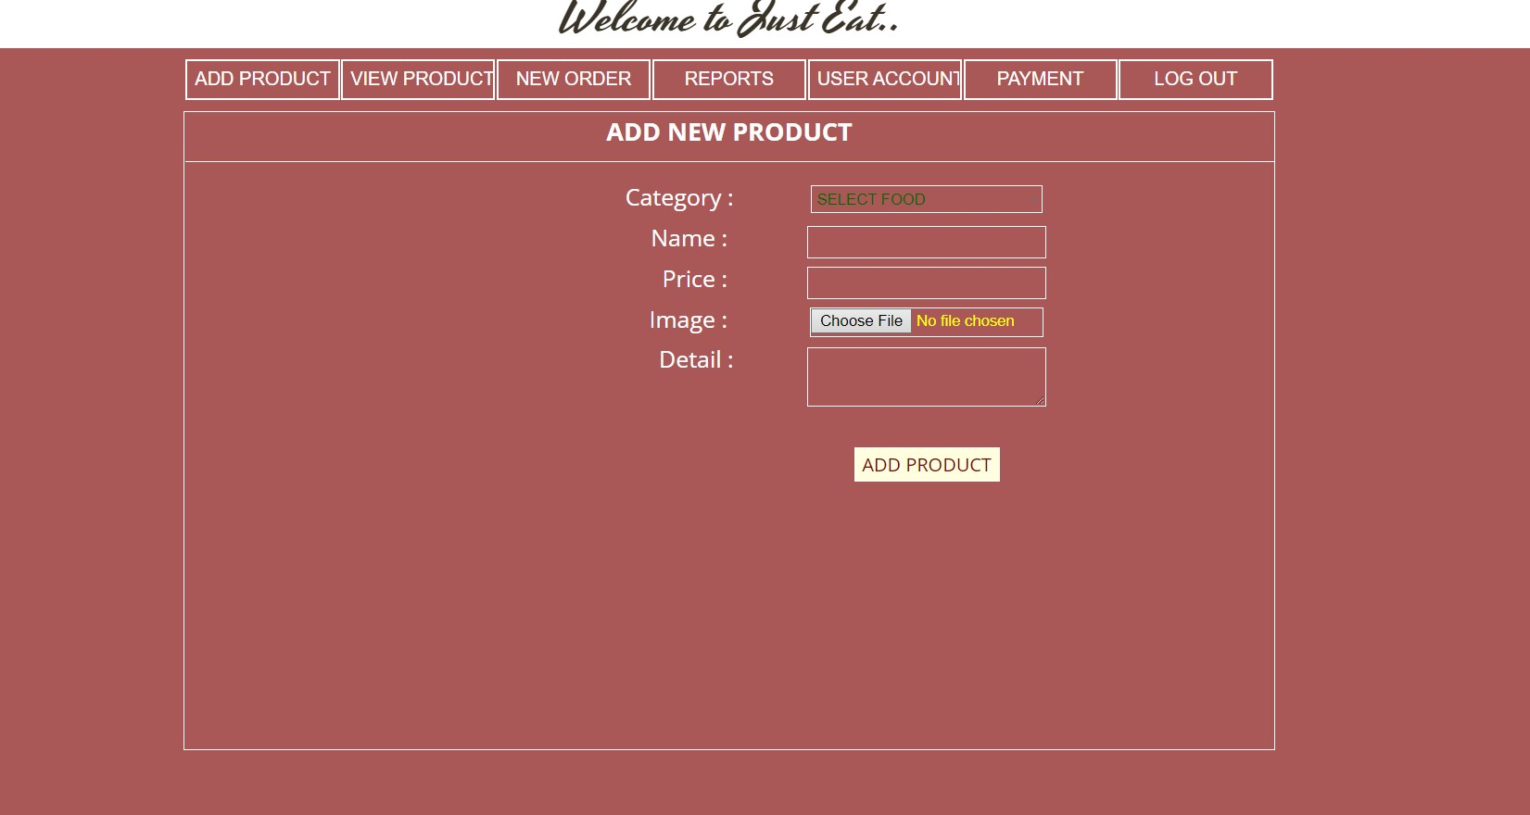
RESULT
Add New Product

Slide 15
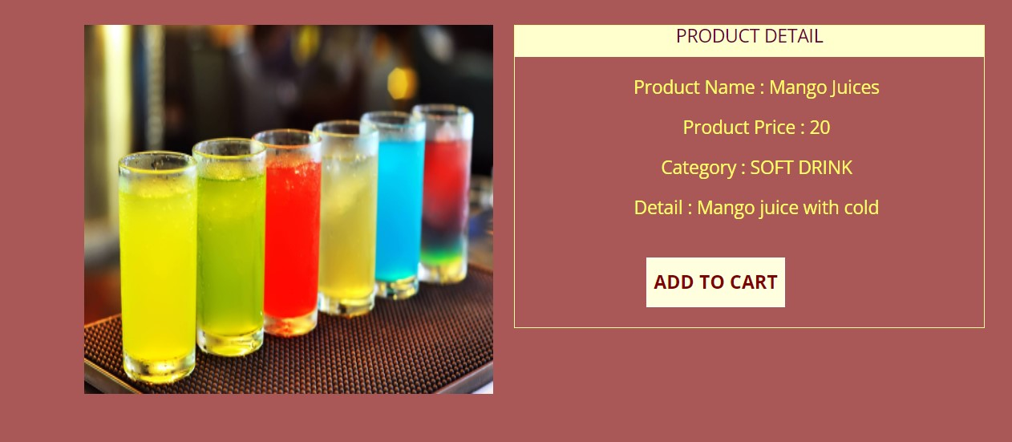
RESULT
Product Detail

Slide 16
CONCLUSIONS
The package was designed in such a way that future modifications can be done easily. The following conclusions can be deduced from the development of the project.
Food Ordering System improves the efficiency.
It provides a friendly graphical user interface which proves to be better when compared to the existing system.
It gives appropriate access to the authorized users depending on their permissions
It effectively overcomes the delay in communications.
Updating of information becomes so easier.
RMS makes works easy and faster than current applications.
All the data will be saved in the database. So the administer can view all the data on time.
This system reduces manual works.
The System has adequate scope for modification in future if it is necessary.

Slide 17
FUTURE ENHANCEMENT
The following section describes the work that will be implemented with future releases of the software.
• Customize orders: Allow customers to customize food orders
• Enhance User Interface by adding more user interactive features. Provide Deals and promotional Offer details to home page. Provide Recipes of the Week/Day to Home Page
• Payment Options: Add different payment options such as PayPal, Cash, Gift Cards etc. Allow to save payment details for future use.
• Allow to process an order as a Guest
• Delivery Options: Add delivery option
• Order Process Estimate: Provide customer a visual graphical order status bar
• Order Status: Show only Active orders to Restaurant Employees.
• Order Ready notification: Send an Order Ready notification to the customer • Restaurant Locator: Allow to find and choose a nearby restaurant

Slide 18
REFERENCES
Microsoft Visual C# Step by Step (Developer Reference Edition).
RamezElmasri and Shamkant B. Navathe, Fundamentals of Database Systems.
Learn SQL Tutorial – javatpoint
MS SQL Server Tutorial (tutorialspoint.com)
C# Tutorial - GeeksforGeeks
What is .NET Framework? Explain Architecture & Components (guru99.com)

Slide 19
Question and Answer

Slide 20
THANK YOU

